Slide 1
GLOBAL SUPER STORE PROJECT
ANALYSING SALES ACCROSS MARKET
By: Akinlade Adeola
Jadon’s Mentorship Program project

Slide 2
OBJECTIVE
Analyze sales and profit performance across global market and product categories .
Identifying top performing regions, products and customer segment.
Understanding key performing drivers and recommended actions for improved profitability.

Slide 3

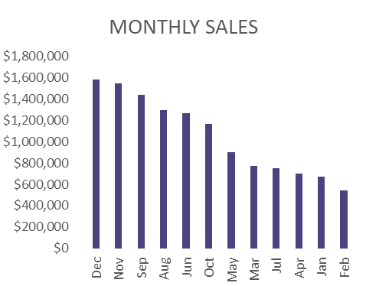
Consistent sales growth across months. Noticeable peak in November and December which indicates healthy year end performance.

Slide 4
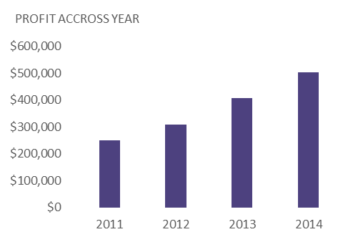
The year with the highest profit is shown to be 2014 with $600,000, this shows that there was improvement in sales over the years.

Slide 5






KEY PERFORMANCE INDICATORS

Slide 6
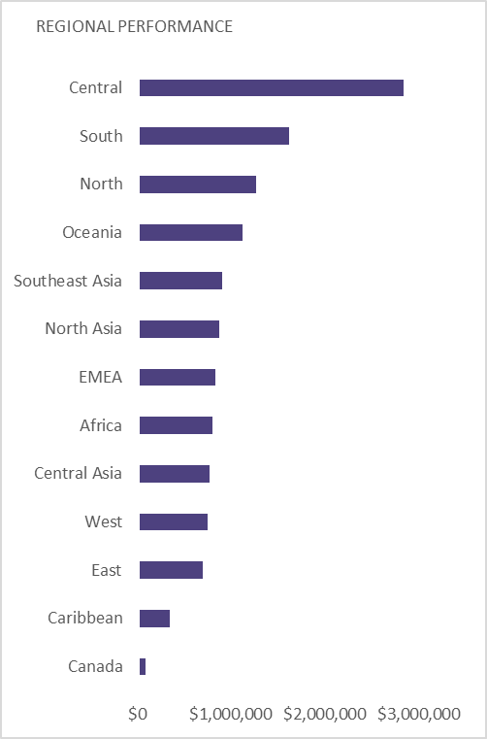
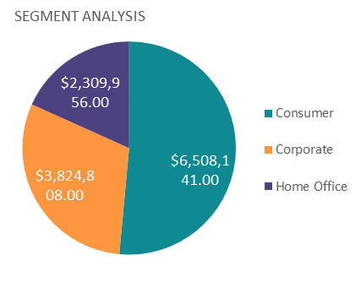
Central and South regions are leading in sales. Some regions show high sales but lower profit.
Cooperate segment dominates revenue.

Slide 7
CONCLUSION
Sales and profit show steady growth across years
Technology drives most profitability
Focus on high-margin products and efficient shipping
Continue tracking regional and segment trends for better decisions

